Slide 1
24
Boost Libraries,
Technical Report 1 and C++0x

Slide 2
Outstanding leaders go out of their way to
boost the self-esteem of their personnel.
  Sam Walton
Practice and thought might
gradually forge many an art.
  Virgil
I think “No comment” is a splendid expression.
  Sir Winston Spencer Churchill

Slide 3
So long as you are secure you
will count many friends.
  Ovid
The danger from computers is not that
they will eventually get as smart as men,
but we will meanwhile agree to meet them halfway.
  Bernard Avishai

Slide 4
OBJECTIVES
In this chapter you’ll learn:
Future directions for C++.
What the Boost Libraries are.
A brief history of the Boost open source project, how new libraries are added to Boost, and how
to install Boost.
To use Boost.Regex to search for strings,
validate data and replace parts of strings
using regular expressions.

Slide 5
OBJECTIVES
To avoid memory leaks by using Boost.Smart_ptr to manage dynamic memory allocation and deallocation.
What Boost (and other) libraries are included in Technical Report 1 (TR1)—a description of the additions to the C++ Standard Library.
The changes to the core language and Standard Library coming in the new C++ Standard—C++0x.
To follow the Deitel online C++ Resource Centers for updates on the evolution of Boost, the Technical Reports and C++0x.

Slide 6
24.1 Introduction
24.2 Deitel Online C++ and Related Resource Centers
24.3 Boost Libraries
24.4 Adding a New Library to Boost
24.5 Installing the Boost Libraries
24.6 Boost Libraries in Technical Report 1 (TR1)
24.7 Regular Expressions with the Boost.Regex Library
24.7.1 Regular Expression Example
24.7.2 Validating User Input with Regular Expressions
24.7.3 Replacing and Splitting Strings

Slide 7
24.8 Smart Pointers with Boost.Smart_ptr
24.8.1 Reference Counted shared_ptr
24.8.2 weak_ptr: shared_ptr Observer
24.9 Technical Report
24.10 C++0x
24.11 Core Language Changes
24.12 Wrap-Up

Slide 8
24.2 Deitel Online C++ and Related Resource Centers
www.deitel.com/CPlusPlusBoostLibraries/
www.deitel.com/cplusplus/

Slide 9
24.3 Boost Libraries
www.boost.org
70+ free, open source C++ libraries
Peer-reviewed

Slide 10
24.4 Adding a New Library to Boost
Libraries must conform to the C++ standard
Use only the C++ Standard Library and other Boost libraries
Complete formal review process
Conform to Boost Software License
  Free for commercial and noncommercial use

Slide 11
24.5 Installing the Boost Libraries
www.boost.org/more/getting_started/
www.deitel.com/books/cpphtp6

Slide 12
24.6 Boost Libraries in Technical Report 1 (TR1)
TR1 is a description of proposed changes and additions to the C++ Standard Library
Many of the libraries in TR1 originated in Boost

Slide 13
24.6 Boost Libraries in Technical Report 1 (TR1) (Cont.)
Boost.Array
  Fixed-size arrays
  Support most of the STL container interface
  Enables use of fixed-size arrays in STL applications
Boost.Bind
  Adapt functions that take up to nine arguments
  Reorder the arguments passed to the function using placeholders

Slide 14
24.6 Boost Libraries in Technical Report 1 (TR1) (Cont.)
Boost.Function
  Store function pointers, member-function pointers and function objects in a function wrapper
  Store a reference to a function object using the ref and cref functions added to the <utility> header
  Hold any function whose arguments and return type can be converted to match the signature of the function wrapper

Slide 15
24.6 Boost Libraries in Technical Report 1 (TR1) (Cont.)
Boost.mem_fn
  Create a function object with a pointer, reference or smart pointer to a member function
  The member function may take more than one argument
  mem_fn is a more flexible version of mem_fun and mem_fun_ref.

Slide 16
24.6 Boost Libraries in Technical Report 1 (TR1) (Cont.)
Boost.Random
  Pseudo-random number generator uses an initial state to produce seemingly random numbers—using the same initial state produces the same sequence of numbers
    Often used in testing
  Nondeterministic random number generator—a set of random numbers that can’t be predicted
    simulations and security scenarios where predictability is undesirable.
  Specify the distribution of the numbers generated

Slide 17
24.6 Boost Libraries in Technical Report 1 (TR1) (Cont.)
Boost.Ref
  reference_wrapper object contains a reference and allows an algorithm to use it as a value
  Improves performance when passing large objects to an algorithm
Boost.Regex
  Regular expressions
  Match specific character patterns in text
  Search for a particular expression in a string
  Replace parts of a string that match a regular expression
  Split a string into tokens using regular expressions to define the delimiters
  Text processing, parsing and input validation

Slide 18
24.6 Boost Libraries in Technical Report 1 (TR1) (Cont.)
result_of
  Specify the return type of a call expression based on the types of the arguments
  Helpful in templatizing the return types of functions and function objects

Slide 19
24.6 Boost Libraries in Technical Report 1 (TR1) (Cont.)
Boost.Smart_ptr
  manage dynamically allocated resources
  shared_ptrs handle lifetime management of dynamically allocated objects
  weak_ptrs allow you to observe the value held by a shared_ptr without assuming any management responsibilities
Boost.Tuple
  create sets of objects in a generic way and allows generic functions to act on those sets
  basically an extension to the STL’s std::pair

Slide 20
24.6 Boost Libraries in Technical Report 1 (TR1) (Cont.)
Boost.Type_traits
  determine specific traits of a type (e.g., is it a pointer or a reference type, or does the type have a const qualifier?)
  perform type transformations to allow the object to be used in generic code

Slide 21
24.7 Regular Expressions with the Boost.Regex Library
Regular expressions
  Specially formatted strings that are used to find patterns in text
  Can be used to validate data to ensure that it is in a particular format

Slide 22
24.7 Regular Expressions with the Boost.Regex Library (Cont.)
The Boost.Regex library
  Include the header file "boost/regex.hpp"
  Class template basic_regex represents a regular expression
  Algorithm regex_match returns true if a string matches the regular expression
    The entire string must match the regular expression
  Algorithm regex_search returns true if any part of an arbitrary string matches the regular expression

Slide 23
24.7 Regular Expressions with the Boost.Regex Library (Cont.)
A character class is an escape sequence that represents a group of characters
  A word character (\w) is any alphanumeric character or underscore
  A whitespace character (\s) is a space, tab, carriage return, newline or form feed
  A digit (\d) is any numeric character

Slide 24
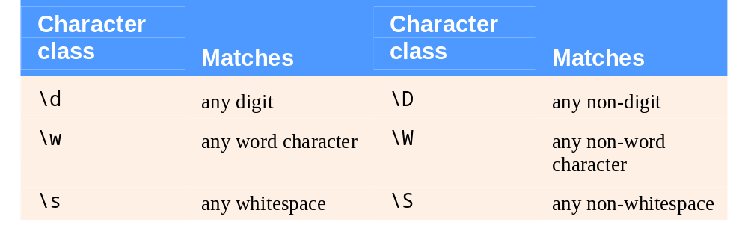
Fig. 24.1 | Character classes.

Slide 25
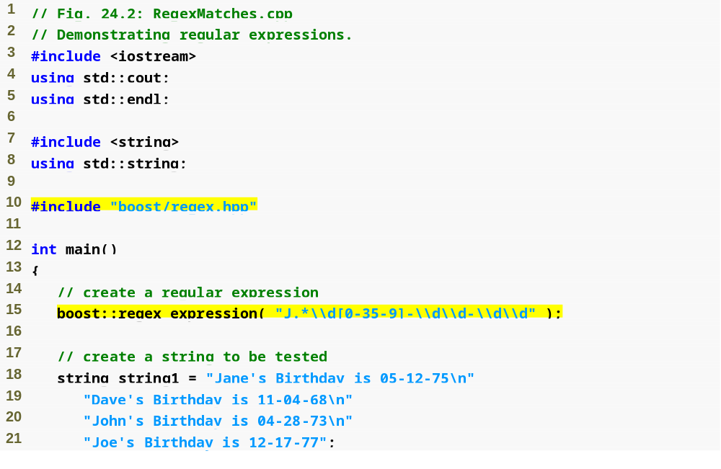
Outline
RegexMatches.cpp
(1 of 2)
Include regex.hpp header file
regex typedef represents a regular expression
string to be searched

Slide 26
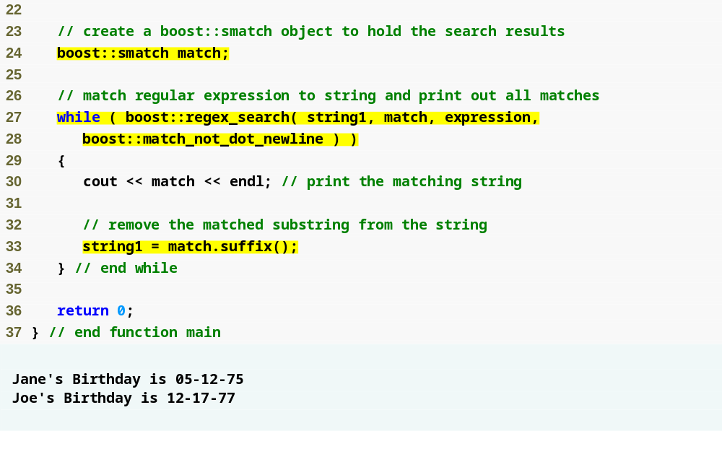
Outline
match_results object that stores matches as a string::const_iterator
RegexMatches.cpp
(2 of 2)
Search the string until no matches can be found
“.” character won’t match a newline character
Return the original string starting at the end of the match

Slide 27
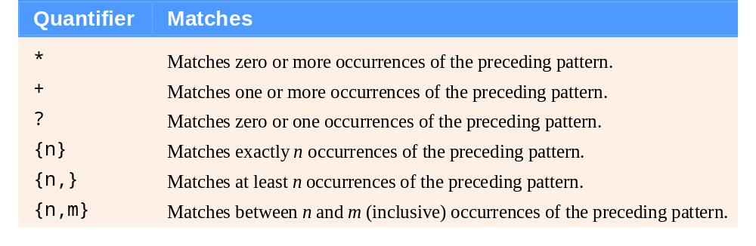
Fig. 24.3 | Quantifiers used in regular expressions.

Slide 28
24.7.1 Regular Expression Example
You must escape the backslash character with another backslash, the character class \d must be represented as \\d in a C++ string literal
The dot character "." matches any character
Characters can be listed in square brackets, []
  The pattern "[aeiou]" matches any vowel
  Ranges of characters are represented by placing a dash (-) between two characters
  ^ specifies that a pattern should match anything other than the characters in the brackets

Slide 29
24.7.1 Regular Expression Example (Cont.)
Quantifiers are greedy—they match as many occurrences of the pattern as possible
If a quantifier is followed by a question mark (?), the quantifier becomes lazy and will match as few occurrences as possible as long as there is a successful match.

Slide 30
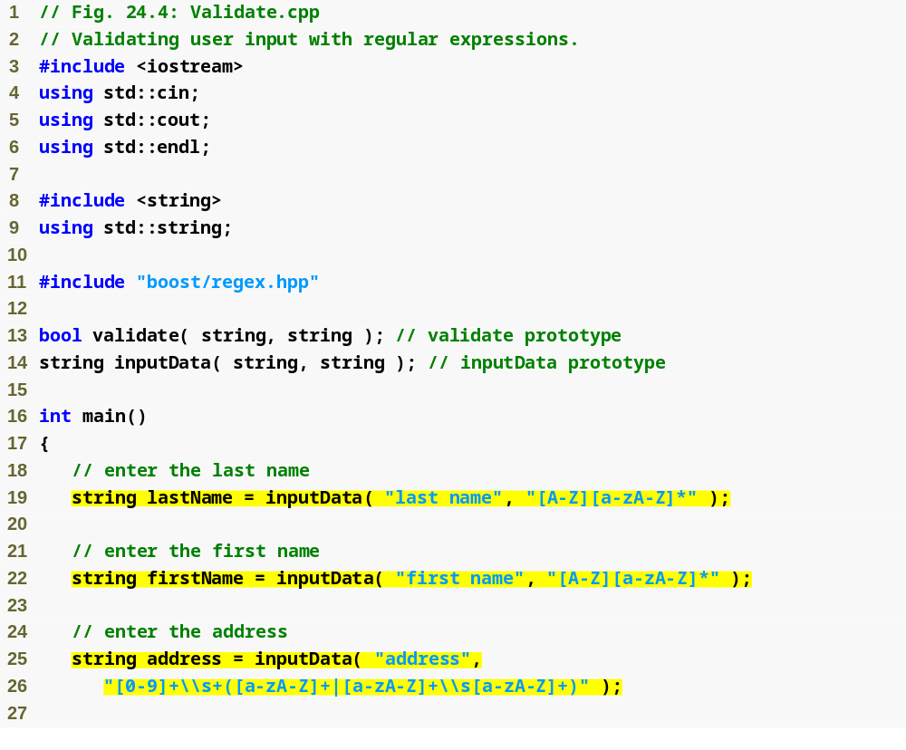
Outline
Validate.cpp
(1 of 4)
Get data from the user

Slide 31
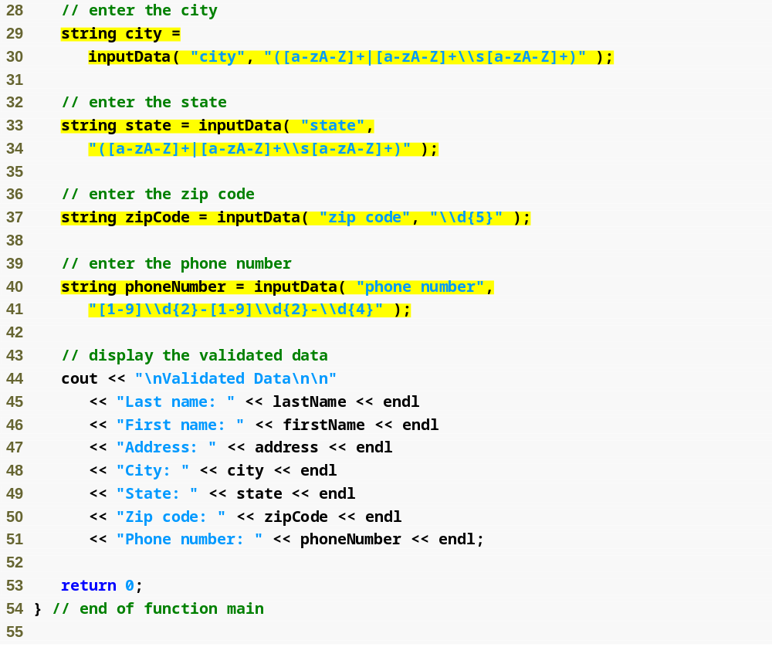
Outline
“|” matches the expression on its left or its right
Validate.cpp
(2 of 4)
Display the validated data

Slide 32
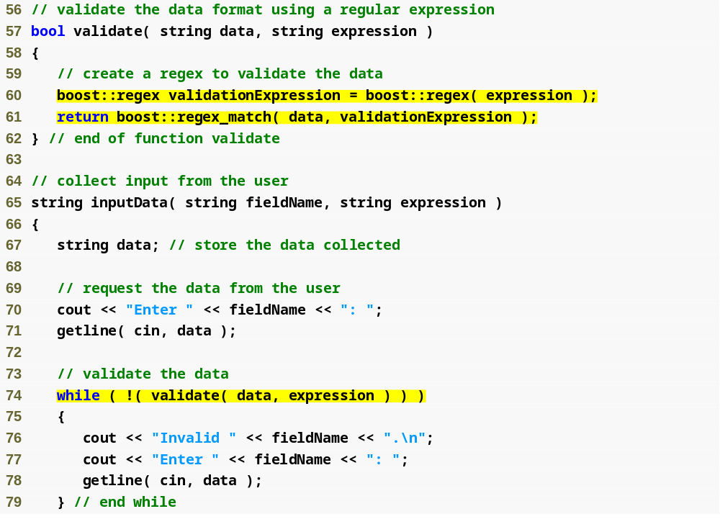
Outline
Validate.cpp
(3 of 4)
Return true if the entire string matches the regular expression
Collect input until the data matches the regular expression

Slide 33
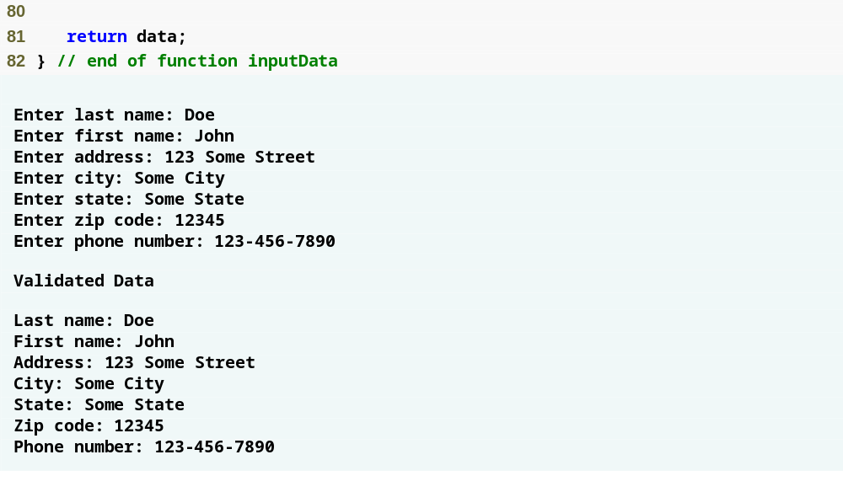
Outline
Validate.cpp
(4 of 4)

Slide 34
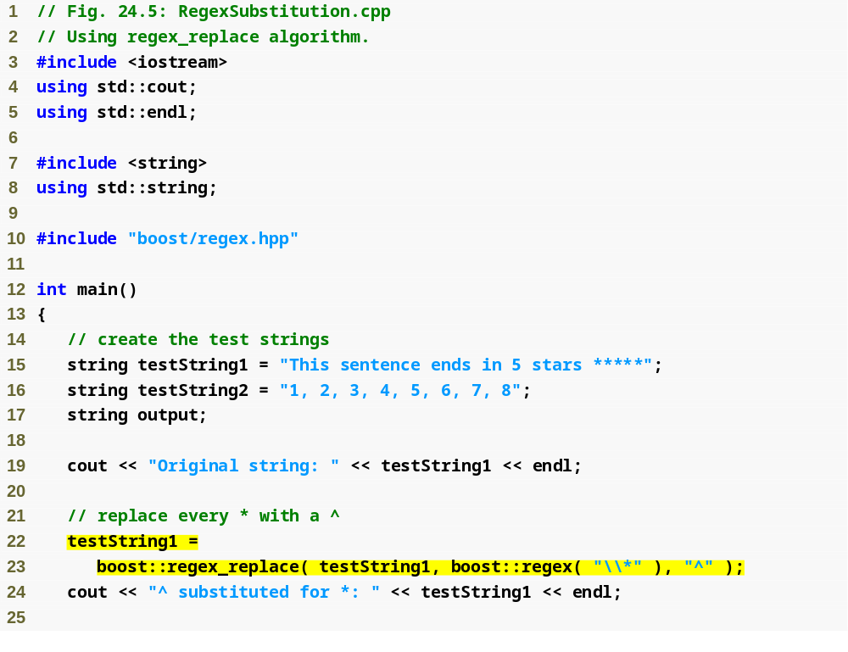
Outline
RegexSubstitution
.cpp
(1 of 3)
strings to manipulate
Replace all occurrences of * with ^
Escape the * to search for the literal character “*”

Slide 35
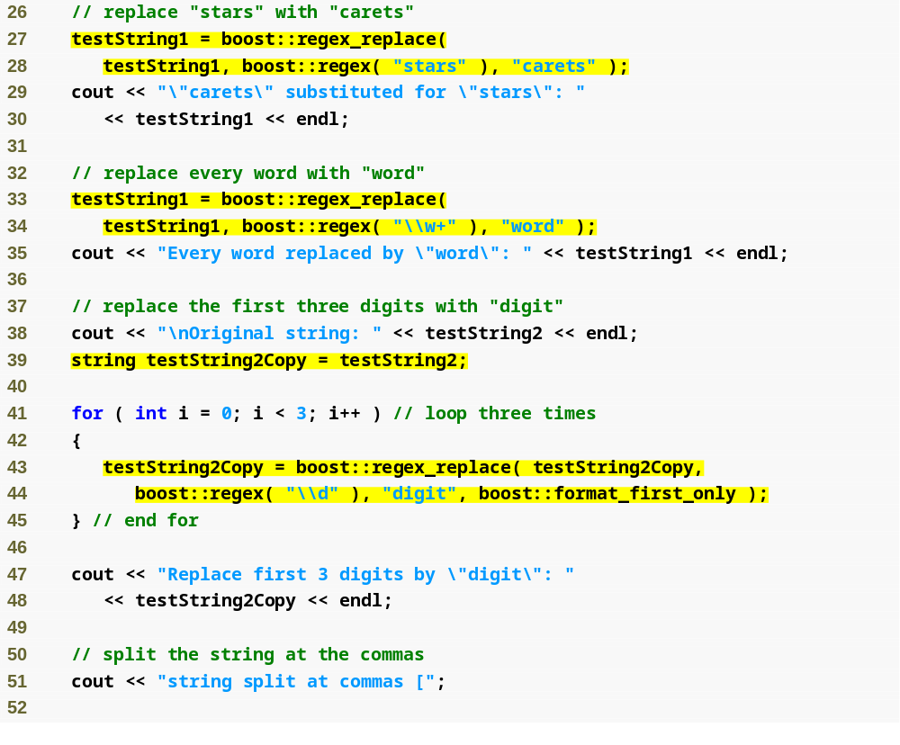
Outline
Replace the word “stars” with “carets”
RegexSubstitution
.cpp
(2 of 3)
Replace every word
(one or more word characters)
Replace only the first match

Slide 36
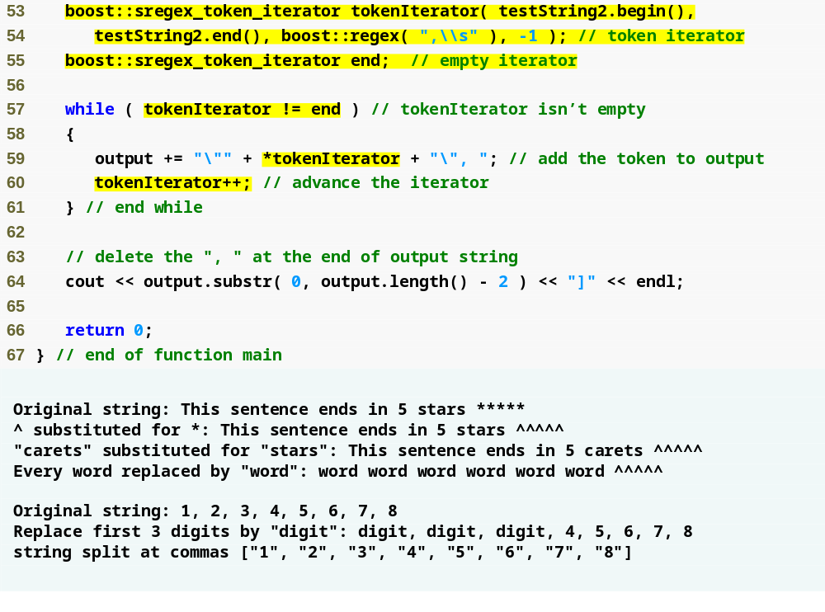
Outline
sregex_token_iterator typedef manipulates tokens as string::const_iterator
Iterate over substrings that don’t match the regular expression
RegexSubstitution
.cpp
(3 of 3)

Slide 37
24.8 Smart Pointers with Boost.Smart_ptr
Smart pointers
  strengthen the process of dynamic memory allocation and deallocation
  Help you write exception safe code
auto_ptr manages dynamically allocated memory
  When copied, ownership of the memory is transferred and the original is set to NULL
  Deletes the memory when destroyed
  Can’t point to an array
  Can’t be used with the STL containers
TR1 includes shared_ptr and weak_ptr

Slide 38
24.8.1 Reference Counted shared_ptr
shared_ptr
  holds an internal pointer to a resource (e.g., a dynamically allocated object) that may be shared with other objects in the program
  Can have any number of shared_ptrs to the same resource
  If you change the resource with one shared_ptr, the changes will be “seen” by the other shared_ptrs

Slide 39
24.8.1 Reference Counted shared_ptr (Cont.)
shared_ptr
  Internal pointer is deleted once the last shared_ptr to the resource is destroyed
  Use reference counting to determine how many shared_ptrs point to the resource
  Can safely be copied and used in STL containers
A custom deleter function, or function object, can be used to destroy the resource

Slide 40
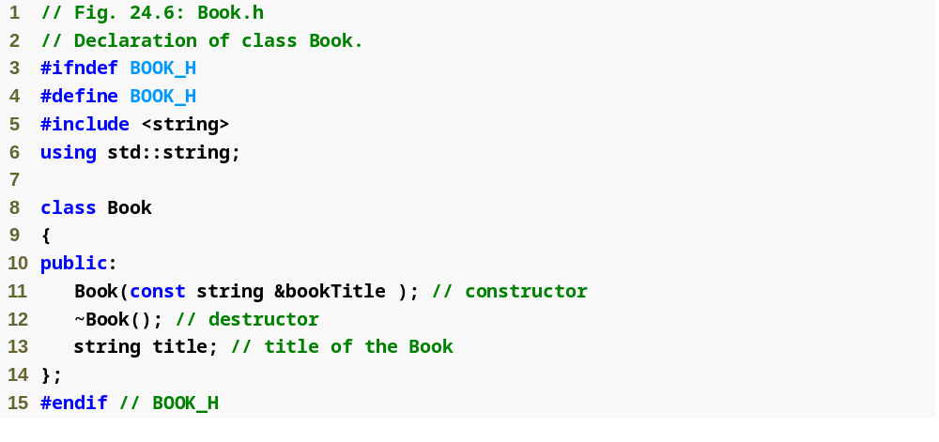
Outline
Book.h

Slide 41
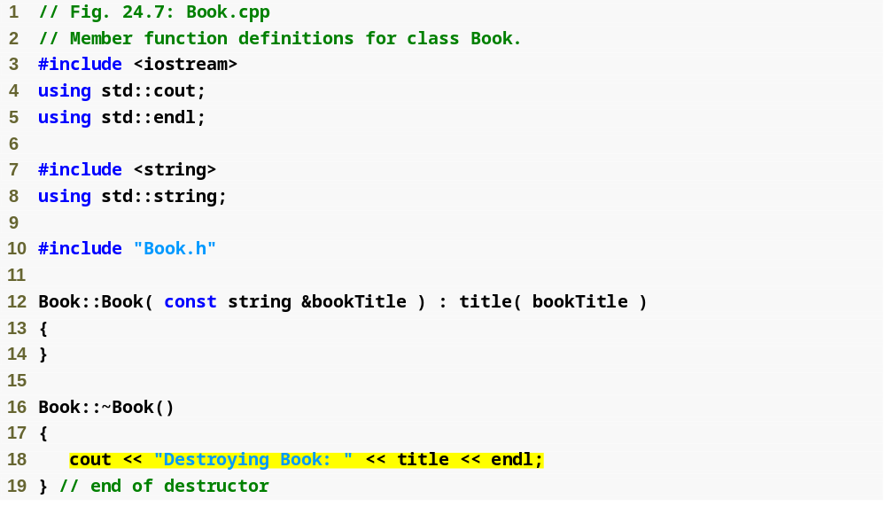
Outline
Book.cpp
Indicate that an instance of class Book is being destroyed

Slide 42
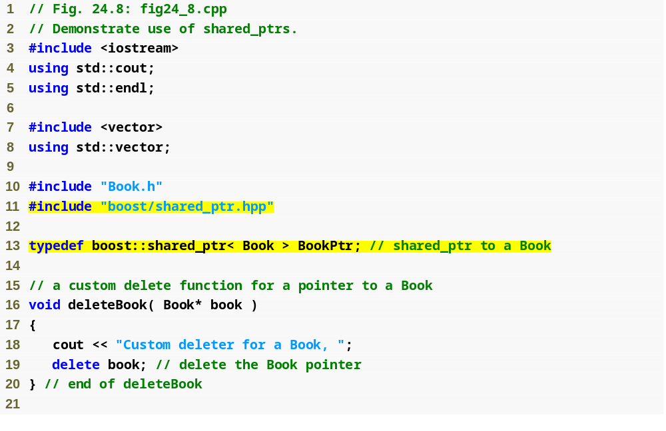
Outline
fig24_8.cpp
(1 of 4)
typedef for a shared_ptr to a Book
Custom deleter function
Display a message and delete the pointer

Slide 43
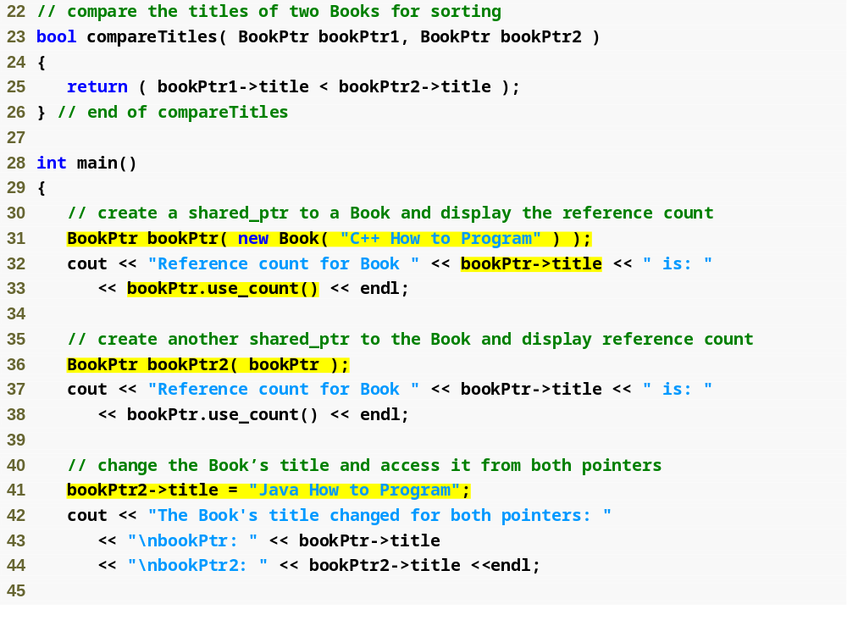
Outline
Compare the titles alphabetically
fig24_8.cpp
(2 of 4)
Create a shared_ptr to a pointer returned by new
Get the reference count for the shared_ptr

Slide 44
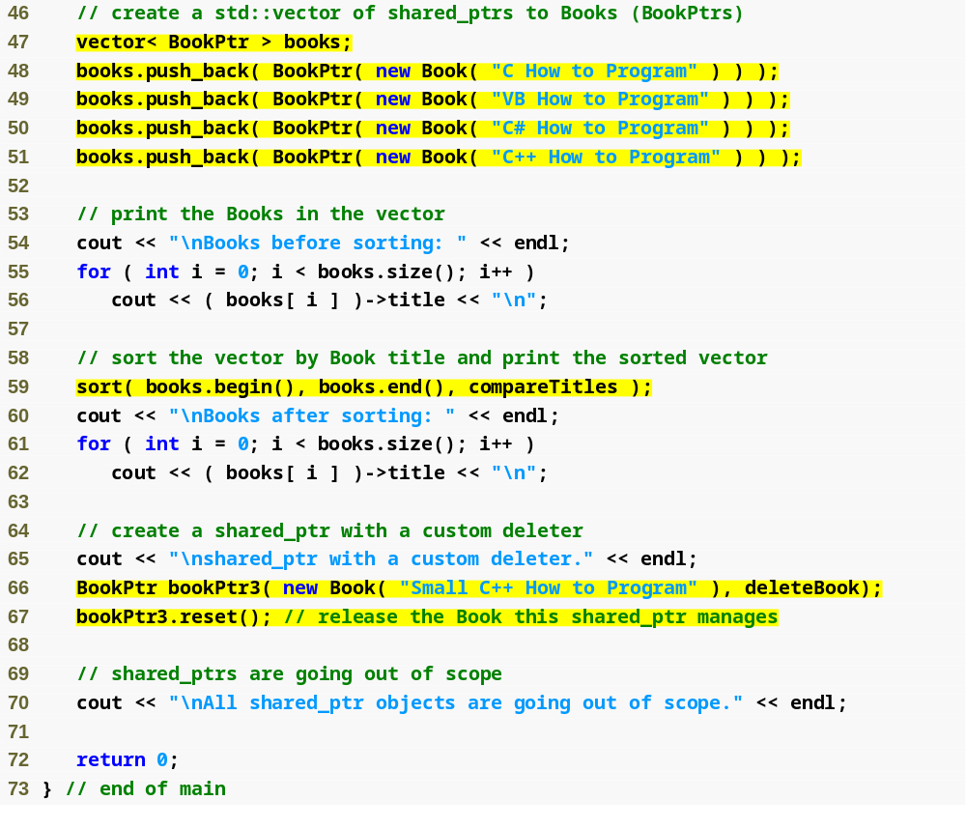
Outline
fig24_8.cpp
(3 of 4)
Add shared_ptrs to a vector
Create a shared_ptr with a custom deleter
Sort the Books by title
Release the shared_ptr’s resource

Slide 45
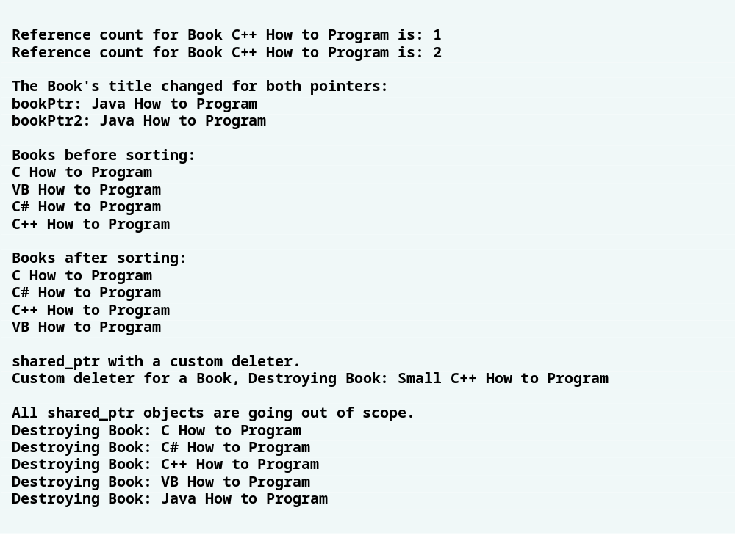
Outline
fig24_8.cpp
(4 of 4)

Slide 46
24.8.2 weak_ptr: shared_ptr Observer
weak_ptr
  points to a resource managed by a shared_ptr without assuming any responsibility for it
  shared_ptr reference count doesn’t increase when a weak_ptr references it
  When the last shared_ptr is destroyed, the resource is deleted and any remaining weak_ptrs are set to NULL
  Avoid memory leaks caused by circular references

Slide 47
24.8.2 weak_ptr: shared_ptr Observer (Cont.)
A weak_ptr can’t directly access the resource it points to—you must create a shared_ptr from the weak_ptr to access the resource
  Pass the weak_ptr to the shared_ptr constructor
  If the resource has already been deleted, the shared_ptr constructor will throw a boost::bad_weak_ptr exception
  weak_ptr member function lock returns a shared_ptr to the weak_ptr’s resource
  If the weak_ptr points to NULL, lock will return an empty shared_ptr (i.e., a shared_ptr to NULL)

Slide 48
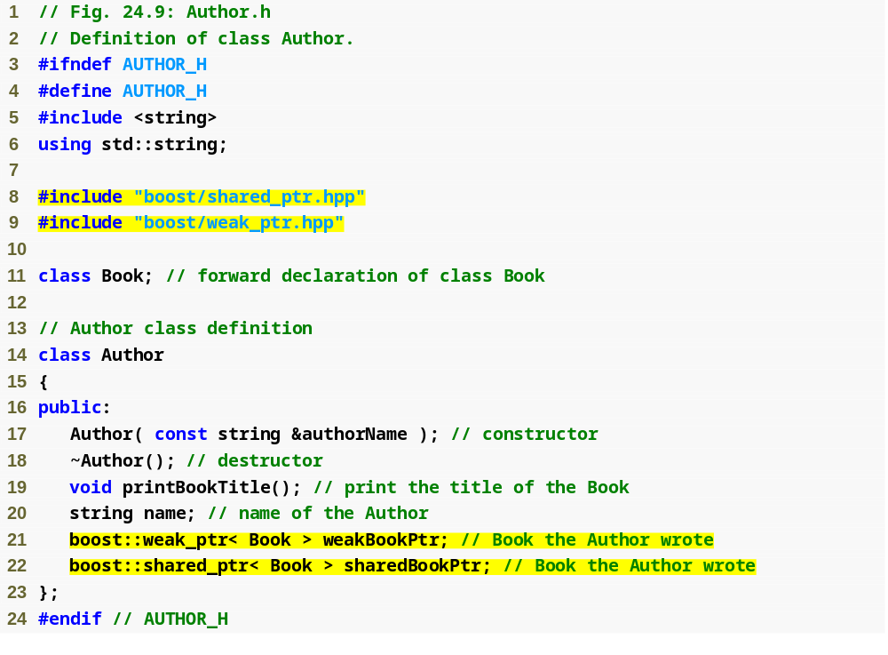
Outline
Author.h
A weak_ptr to a Book
A shared_ptr to a Book

Slide 49
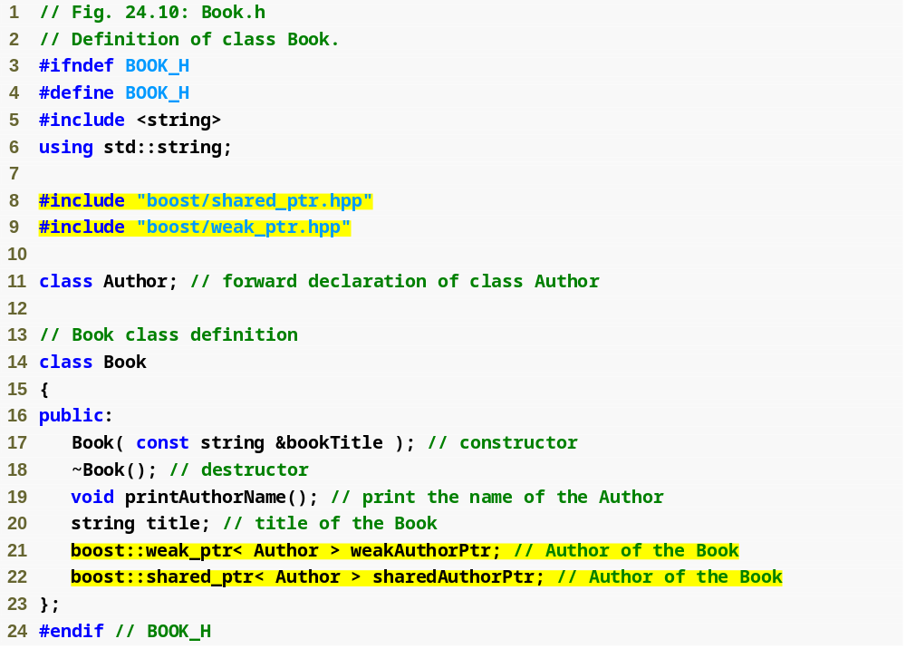
Outline
Book.h
A weak_ptr to an Author
A shared_ptr to an Author

Slide 50
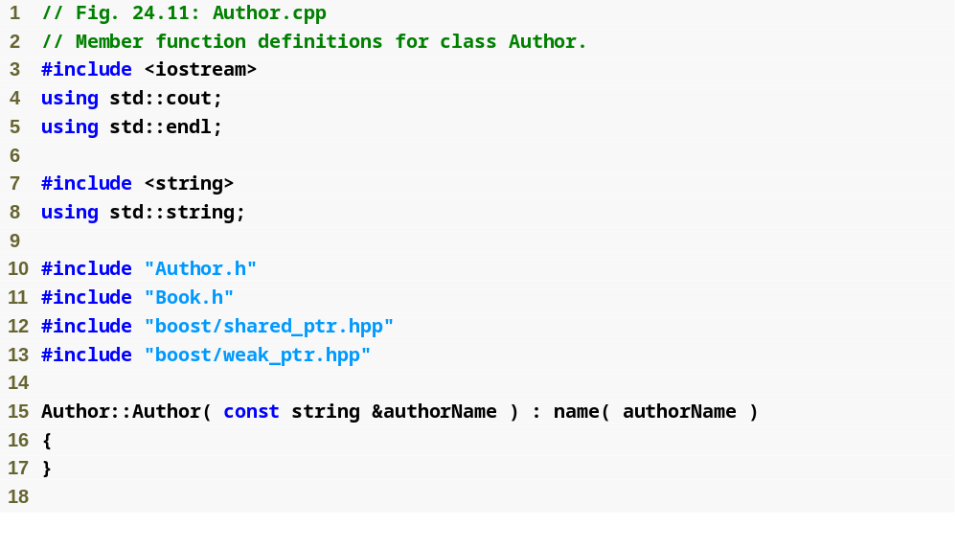
Outline
Author.cpp
(1 of 2)

Slide 51
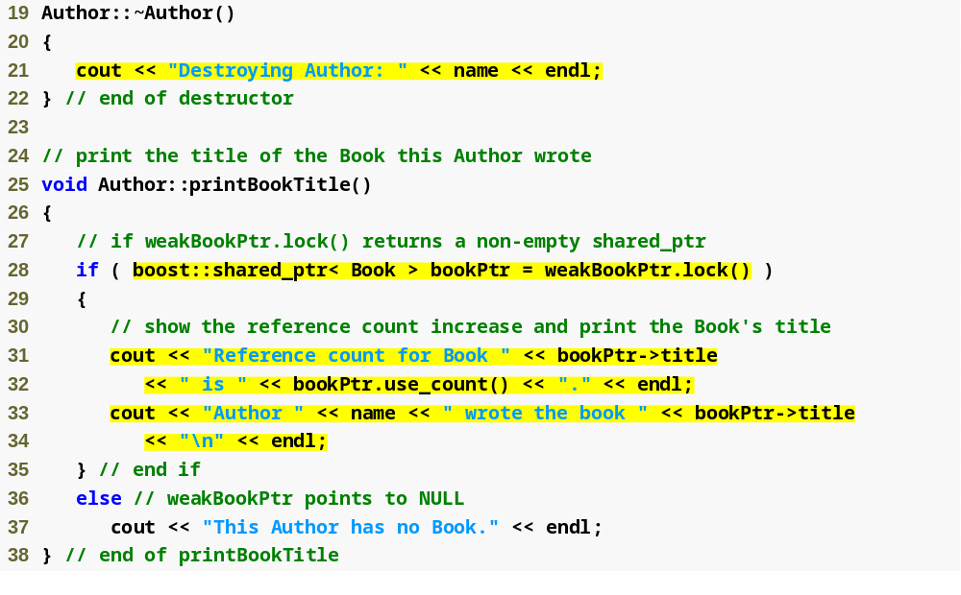
Outline
Indicate when an instance of Author is being destroyed
Author.cpp
(2 of 2)
Create a shared_ptr from the weak_ptr data member to access the resource

Slide 52
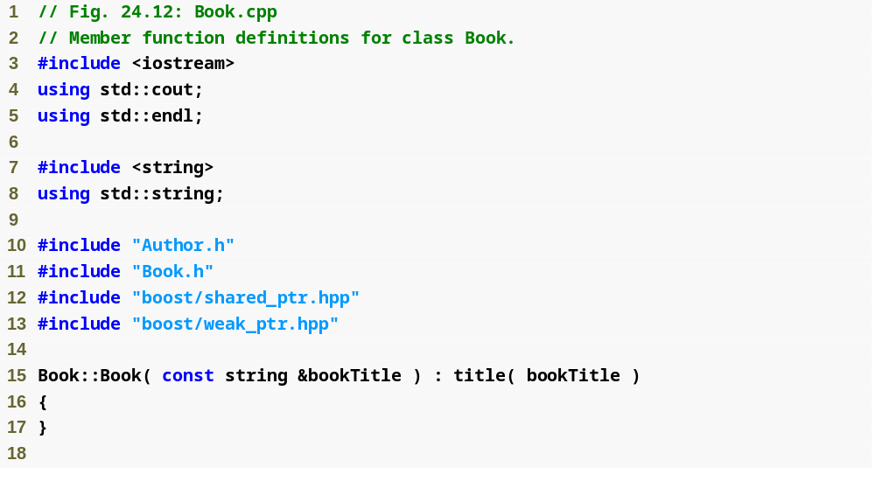
Outline
Book.cpp
(1 of 2)

Slide 53
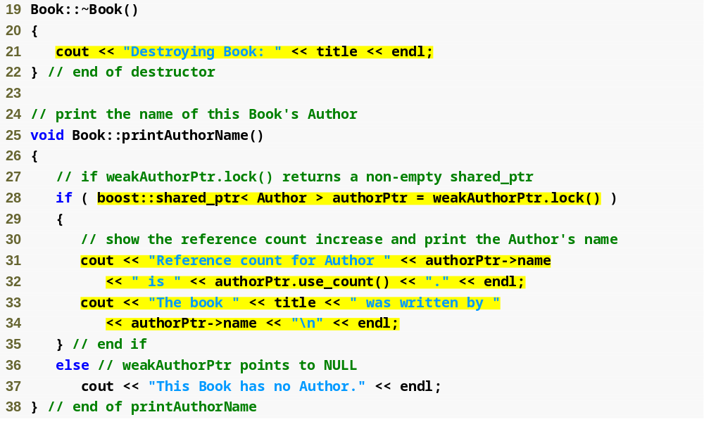
Outline
Indicate when an instance of Book is being destroyed
Book.cpp
(2 of 2)
Create a shared_ptr from the weak_ptr data member to access the resource

Slide 54
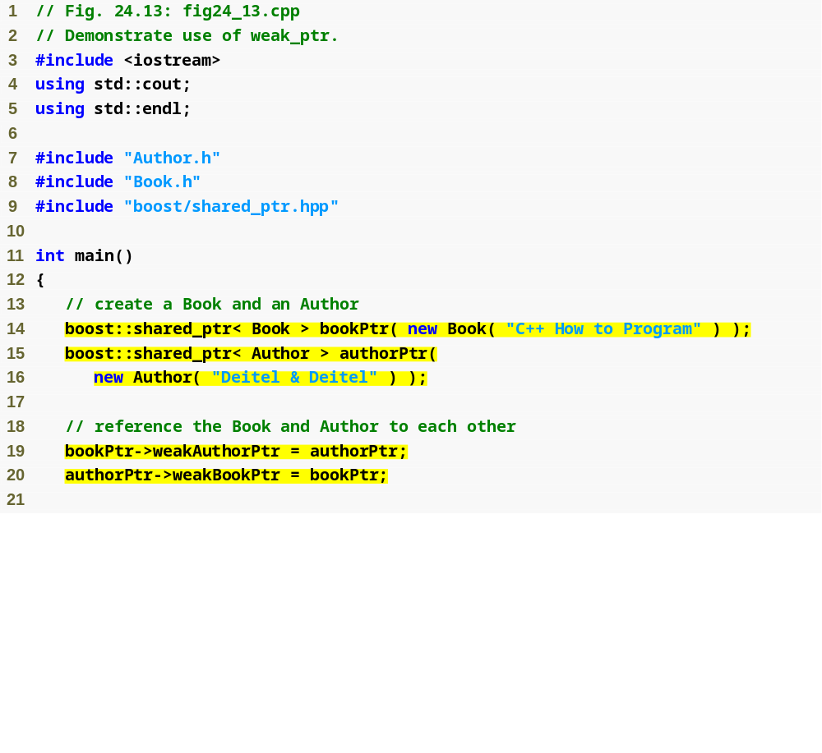
Outline
fig24_13.cpp
(1 of 3)
Create a circular reference between Book and Author using the weak_ptr data members

Slide 55
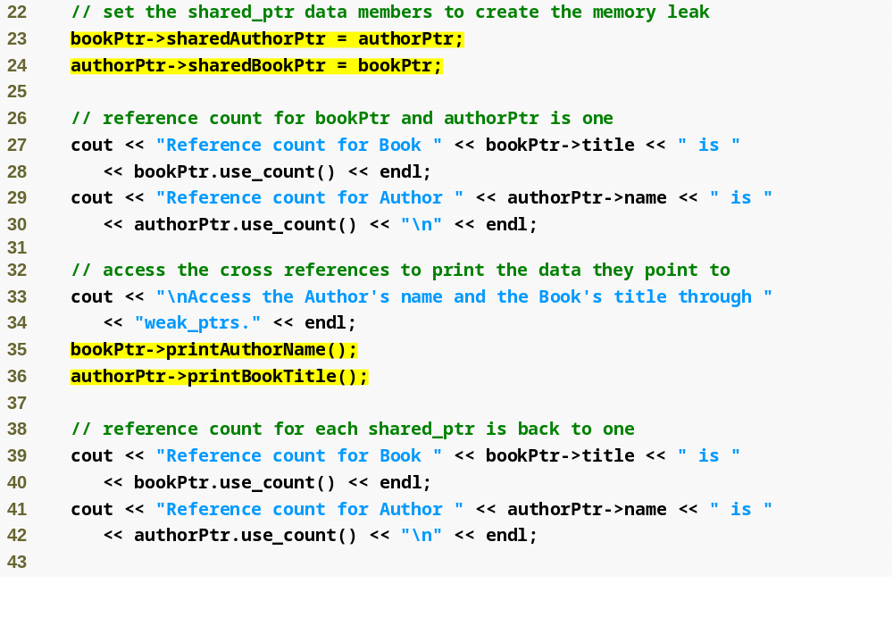
Outline
Create a circular reference between Book and Author using the shared_ptr data members
fig24_13.cpp
(2 of 3)
Print the Book’s Author
Print the Author’s Book

Slide 56
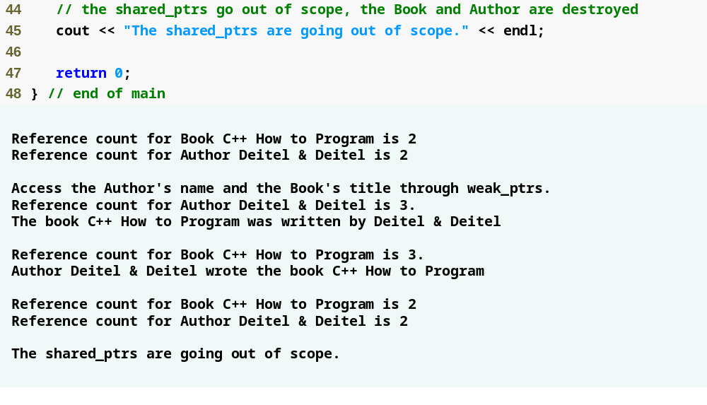
Outline
fig24_13.cpp
(3 of 3)
The instances of Book and Author aren’t destroyed, there is a memory leak

Slide 57
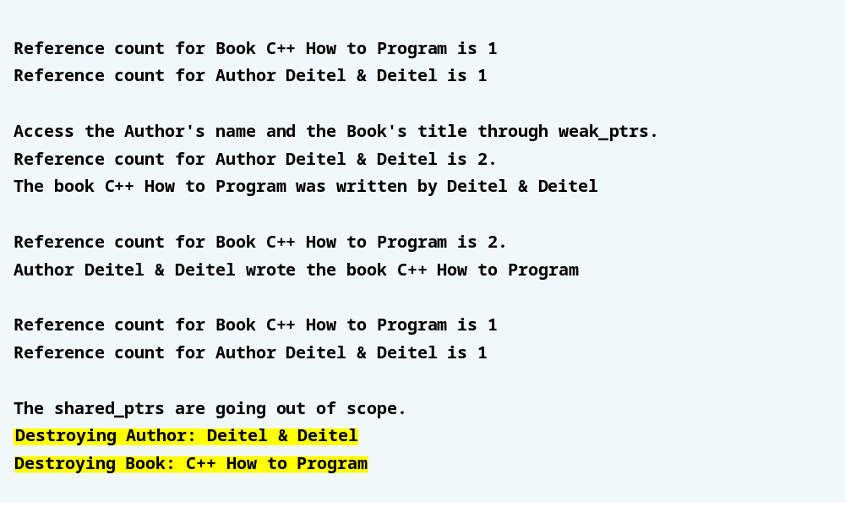
Outline
Fix the memory leak by not setting the shared_ptr data members

Slide 58
24.9 Technical Report 1 (TR1)
Describes proposed additions to the C++ Standard Library
Many of the libraries in TR1 will be accepted by the C++ Standards Committee
  not considered part of the C++ standard until the next version is finalized
Technical Report 2 (TR2)
  will be released shortly after C++0x
  contains additional library proposals that weren’t included in TR1

Slide 59
24.9 Technical Report 1 (Cont.)
The Unordered Associative Containers library
  unordered_set
  unordered_map
  unordered_multiset
  unordered_multimap
  Implemented as hash tables
  Defined in the <unordered_set> and <undordered_map> headers.

Slide 60
24.9 Technical Report 1 (Cont.)
The Unordered Associative Containers library (cont.)
  A key is used to determine where to store an element in the container
  Retrieve an element using the key much as you do with a set or map
  unordered_set and unordered_multiset, the element itself is used as the key
  unordered_map and unordered_multimap use a separate key, elements passed as a
  pair< const Key, Value >
  unordered_set and unordered_map require that all the keys are unique; unordered_multiset and unordered_multimap don’t

Slide 61
24.9 Technical Report 1 (Cont.)
Mathematical Special Functions
  This library incorporates mathematical functions added to C99 that are missing in the C++ Standard
  C99 supplies trigonometric, hyperbolic, exponential, logarithmic, power and special functions
  <cmath> header.
Increased Compatibility with C99
  Increase compatibility between C++ and C99—often by including corresponding C99 headers.

Slide 62
24.10 C++0x
New C++ standard, likely to be released in 2009
Includes the TR1 libraries and changes to the core language

Slide 63
24.10 C++0x (Cont.)
Standardization Process
  The International Organization for Standardization (ISO) oversees the creation of international programming language standards
  ISO/IEC JTC 1/SC 22 Working Group 21 (WG21) maintains the C++ standard
  Meets twice a year to discuss issues pertaining to the standard
  ISO requires at least 5 years between new drafts of a standard.

Slide 64
24.10 C++0x (Cont.)
Goals for C++0x
  Make C++ easier to learn
  Improve library building capabilities
  Increase compatibility with the C programming language

Slide 65
24.11 Core Language Changes
List of the proposed changes to the core language
  www.open-std.org/jtc1/sc22/wg21/docs/papers/2007/n2228.html
GNU C++ compiler
  optional C++0x mode for experimenting with a number of the core language changes http://gcc.gnu.org/gcc-4.3/cxx0x_status.html

Slide 66
24.11 Core Language Changes (Cont.)
Rvalue Reference
  Allows you to bind an rvalue (temporary object) to a non-const reference
  Declared as T&& (where T is the type of the object being referenced)
  Used to implement move semantics
  “Forwarding functions”—function objects that adapt a function to take fewer arguments

Slide 67
24.11 Core Language Changes (Cont.)
static_assert
  Compile time assertions
  Takes a constant integral expression and a string literal
    If the expression evaluates to 0 (false), the compiler reports the error using the string literal provided in the declaration
  Can be used at namespace, class or block scope
  Provide more informative error messages
  Report incorrect library usage much more effectively

Slide 68
24.11 Core Language Changes (Cont.)
extern template
  extern indicates that a variable or function is defined either later in the current file or in a separate file
  extern template provides the same functionality for templates
Extended friend Declarations
  Clarifies the Standard’s wording with respect to friend declarations and templates

Slide 69
24.11 Core Language Changes (Cont.)
Synchronizing the C++ Preprocessor with C99
  Create a C++ compiler and preprocessor with the same rules and features as the C99 compiler and preprocessor
  The changes affect areas including:
    predefined macros
    the pragma operator
    string concatenation
    header and include filenames

Slide 70
24.11 Core Language Changes (Cont.)
Conditionally Supported Behavior
  Any optional feature that is not supported by the current implementation causes the compiler to return a report that the program uses an unsupported feature
  Helps novice programmers who may inadvertently use nonstandard features

Slide 71
24.11 Core Language Changes (Cont.)
Changing Undefined Behavior into Diagnosable Errors
  Changes certain situations which cause undefined behavior into diagnosable error
    oversized integers
    unsupported character escapes
    passing non-POD objects (“plain old data”) to variadic functions

Slide 72
24.11 Core Language Changes (Cont.)
Adding the long long Type to C++
  long long integer type that must be at least 64 bits (8 bytes)
  Improves compatibility with the C99 Standard
Adding Extended Integer Types to C++
  An integer type defined by an implementation in addition to the integer types required by the C++ Standard
  Any signed extended integer type must also have a corresponding unsigned type of the same size
  Explicitly using an extended integer type affects the portability of your program

Slide 73
24.11 Core Language Changes (Cont.)
Delegating Constructors
  A constructor can call another of the class’s constructors
  Easier to write overloaded constructors, common code doesn’t need to be repeated
Right Angle Brackets
  Without the space between trailing right angle brackets, the compiler assumes it’s the right shift operator (>>)
  Writing vector<class<T>> causes a compiler error
  Change the C++ compiler to recognize when >> is part of a template rather than the right-shift operator

Slide 74
24.11 Core Language Changes (Cont.)
Deducing the Type of Variable from Its Initializer
  auto keyword determines variable types based on the initializer expression
  Use in place of long, complicated types
  Can be used with const and volatile qualifiers
  Can create pointers and references as you would with the full type name
  Supports the declaration of multiple variables in one statement (e.g., auto x = 1, y = 2)
  Save time, ease the learning process and simplify generic programming

Slide 75
24.11 Core Language Changes (Cont.)
Variadic Templates
  A variadic template accepts any number of arguments
  Express classes and functions that take an arbitrary number of arguments
  Template parameters are put in a template type parameter pack
  Arguments passed to a function are put in a function parameter pack
  An ellipsis (“...”) to the left of the name of a template or function parameter declares it as a template type parameter pack or function parameter pack, respectively
  An ellipsis to the right of a function parameter extracts all the elements of the parameter pack
  The nth element of a template type parameter pack is the type of the nth element in a function parameter pack

Slide 76
24.11 Core Language Changes (Cont.)
Template Aliases
  Introduces a name used to refer to a template
  Certain parameters are specified and others may still vary
New Character Types
  Unicode character support
  Already supported by the C standard
  char16_t and char32_t represent the 16-bit and 32-bit Unicode characters
  Prefixes u and U denote char16_t or char32_t characters, respectively.

Slide 77
24.11 Core Language Changes (Cont.)
Extending sizeof
  sizeof operator returns the number of bytes used to store an object
  Can be called on a data member without accessing it through an instance of the class
  Used more naturally with static data members
Alternative to Sequence Points
  Changes the wording in the standard to define sequencing requirements more precisely
  Any attempt to add concurrency (i.e., multithreading) requires a solid understanding of the order of events in a program

